Slide 1
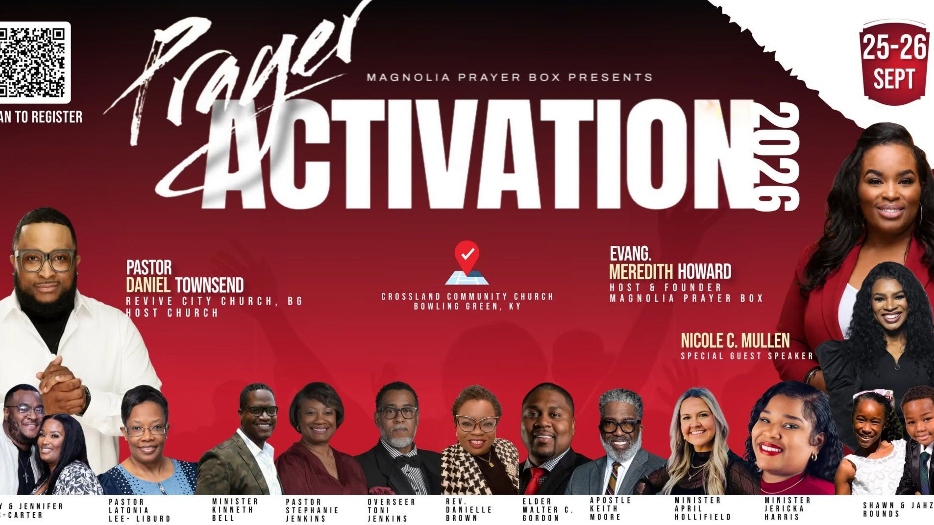

Slide 2
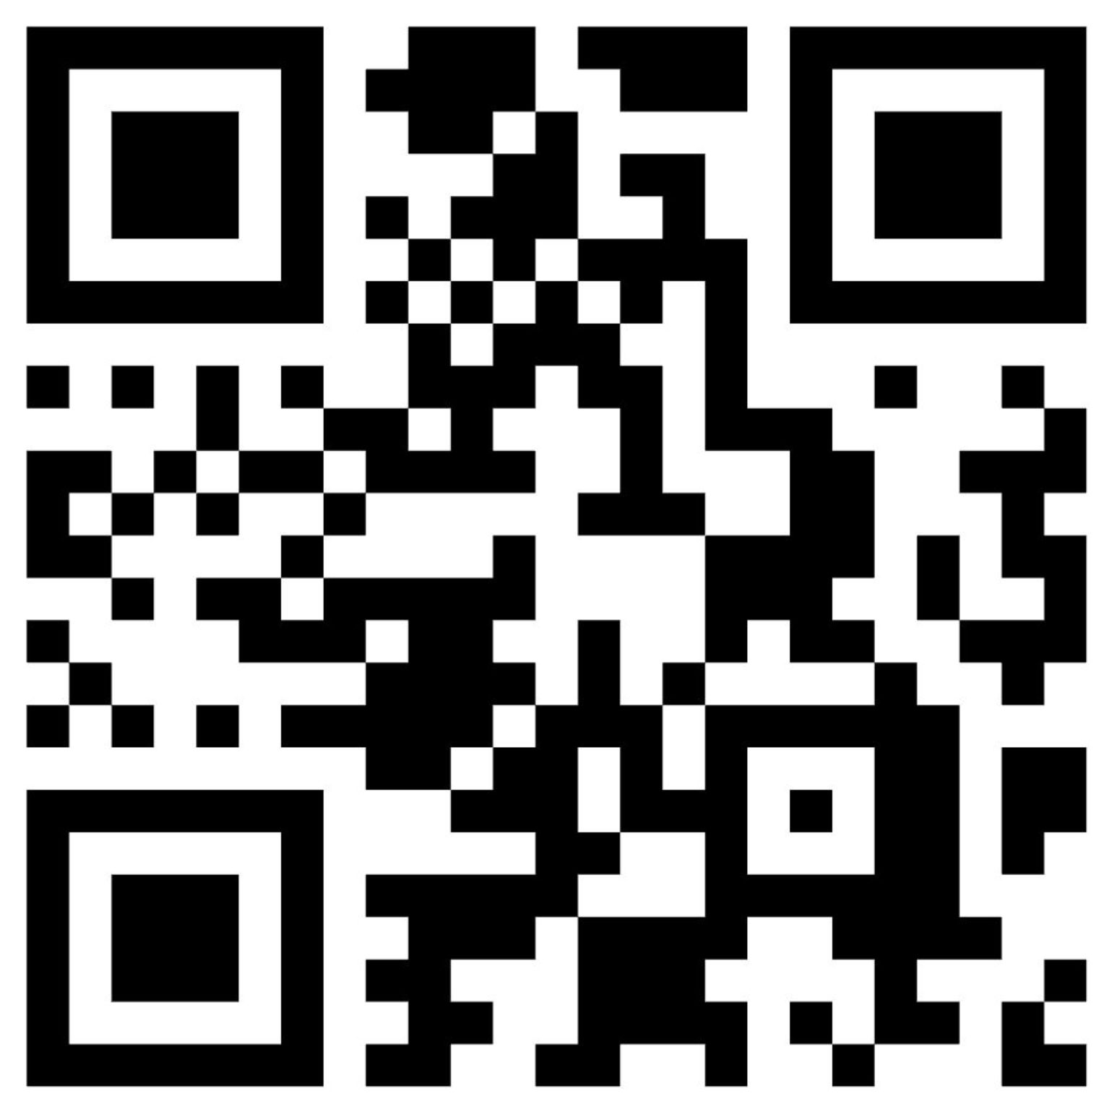
Today's Download
Scan to acces PDF!

Slide 3
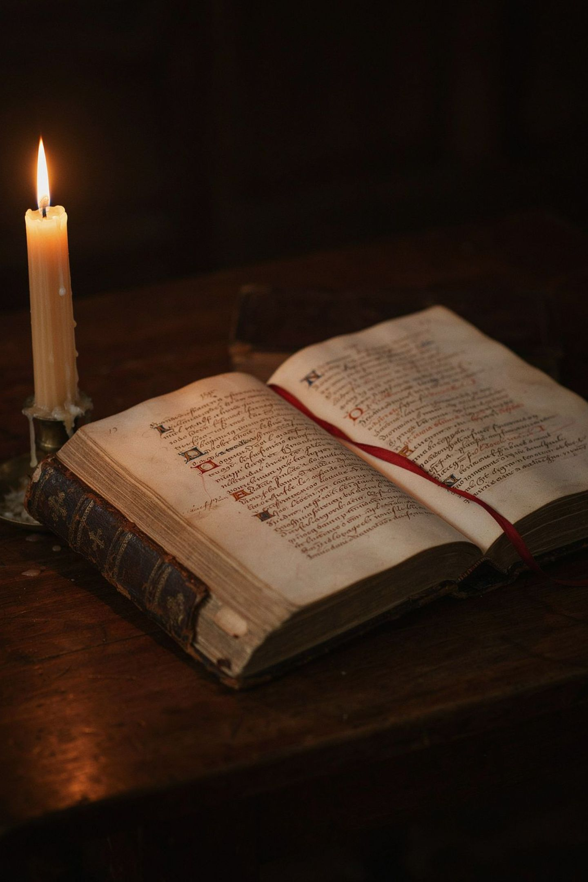
The Blueprint for Prophetic Intercession
"Thy kingdom come, Thy will be done on earth as it is in heaven." — Matthew 6:10
Intercession is not asking God to adopt our plan on Earth. It is enforcing Heaven's established reality on Earth through alignment. Matthew 6:10 is the foundational blueprint — a declaration that Heaven's completed order must be made manifest in the earthly realm through the prayers of God's people.
5 / 16

Slide 4
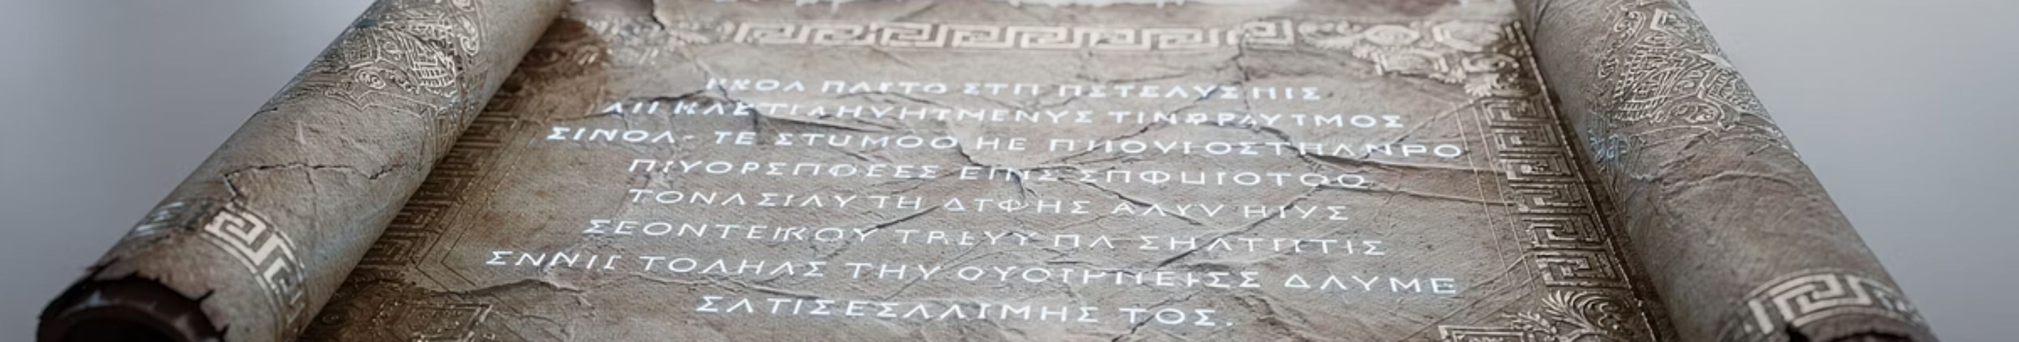
GREEK: Words Behind the Word
Matthew 6:10 - NAS: 'Your kingdom come. Your will be done, On earth as it is in heaven.'
Matthew 6:10 - NA26: ἐλθέτω (5628) ἡ βασιλεία σου, γενηθήτω (5676) τὸ θέλημά σου, ὡς ἐν οὐρανῷ καὶ ἐπὶ γῆς.
To truly grasp the profound meaning of scripture, we delve into the original Greek. Understanding the nuances behind each word empowers a deeper connection to God's prayer for His Kingdom to manifest.
1 / 16

Slide 5

Deep Dive: "Kingdom Come"
Unpacking the original Greek terms reveals the dynamic and powerful nature of this foundational prayer.
Your Kingdom (basileía)
The Greek word basileía (βασιλεία / bas-il-i'-ah) is more than just a place; it signifies:
Royal power, kingship, dominion, and rule – emphasizing authority rather than territory.
The triumphant royal power of Jesus as the Messiah.
The royal power and dignity conferred upon Christians within this reign.
This term calls for the active, sovereign reign of God to be manifest.
Let it Come (érchomai)
The verb érchomai (ἔρχομαι / er'-khom-ahee) describes a dynamic arrival and unfolding:
To come or arrive, for individuals to appear publicly.
Metaporically, to come into being, arise, show itself, or find influence.
It denotes establishment and becoming known.
This is a powerful petition for God's active reign to break forth and be visibly established on Earth as it is in Heaven.
2 / 16

Slide 6
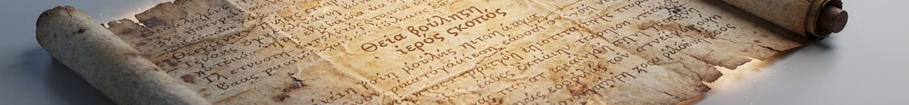
Deep Dive: "Your Will Be Done"
Exploring the divine intent and active manifestation behind this pivotal phrase.
Your Will (thélēma)
The Greek word thélēma (θέλημα / thel'-ay-mah) refers to God's deliberate and sovereign purpose:
What God wishes or has determined shall be done.
God's purpose to bless humanity through Christ.
God's commands, precepts, and desires for us.
Let it Be Done (gínomai)
The verb gínomai (γίνομαι / ghin'-om-ahee) denotes an active, dynamic bringing forth:
To come into existence, begin to be, receive being.
To come to pass, happen, or be established.
To arise, appear, and find influence publicly.
To be made, finished, performed, or wrought (e.g., miracles).
3 / 16

Slide 7
Deep Dive: "On Earth as it is in Heaven"
Continuing our exploration, we unpack the original Greek terms for 'earth' and 'heaven' to understand the full scope of God's desired manifestation.
On Earth (gē)
The Greek word gē (γῆ / geh) is rich with meaning, encompassing all aspects of the terrestrial realm where God's will is to be done:
Arable land: Signifying productivity and sustenance, where divine purpose bears fruit.
The ground, the earth as a standing place: Our foundation and physical reality, where we live and act.
The mainland as opposed to the sea or water: The solid, tangible world, distinct from chaos.
The earth as a whole: The entire planet, a comprehensive sphere of influence.
The inhabited earth, the abode of men and animals: Humanity's dwelling place, where relationships and societies exist.
A country, land enclosed within fixed boundaries, a tract of land, territory, region: Specific territories and nations, subject to divine decree.
This term emphasizes that God's Kingdom is to be established not just spiritually, but tangibly and physically across all aspects of the world and human society.
As it is in Heaven (ouranós)
The term ouranós (οὐρανός / oo-ran-os') refers to the celestial realm, the perfect standard against which earth's transformation is measured:
The vaulted expanse of the sky with all things visible in it: The vastness of the cosmos, both seen and unseen.
The universe, the world: The entirety of creation, governed by divine order.
The aerial heavens or sky: The atmospheric region, where natural phenomena occur in accordance with divine law.
The sidereal or starry heavens: The celestial bodies, operating in perfect alignment and purpose.
The region above the sidereal heavens: The ultimate dwelling place of God and other heavenly beings, characterized by eternal order and consummate perfection.
Our prayer is for the divine order, perfection, and will that are fully present in heaven to be mirrored and manifested completely on earth.
4 / 16

Slide 8
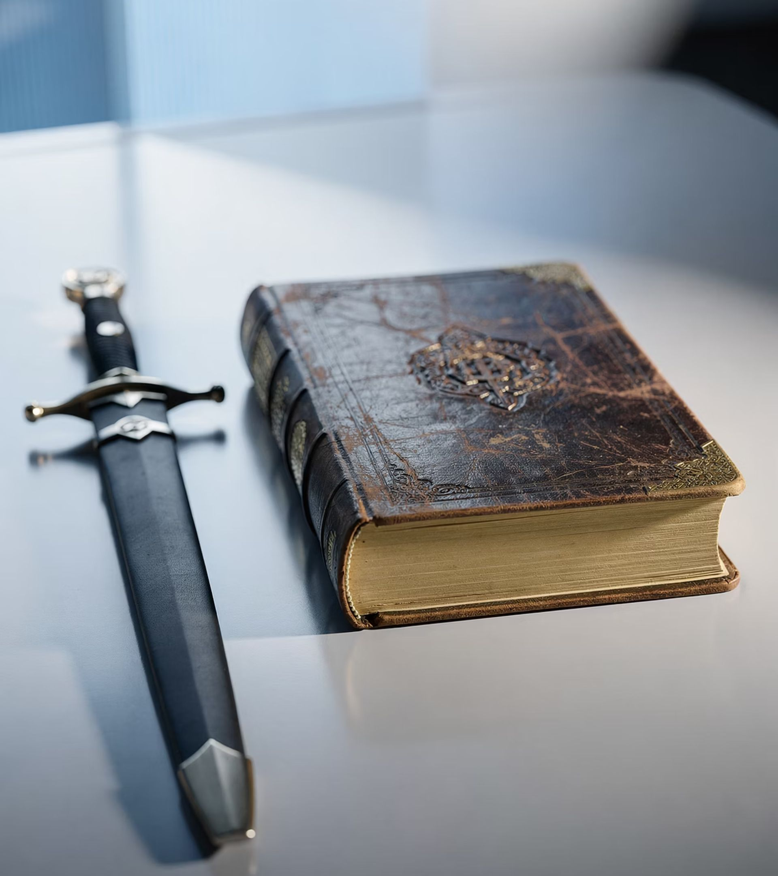
Critical Question?
Are these powerful?
Is there something more powerful than these?
6 / 16

Slide 9
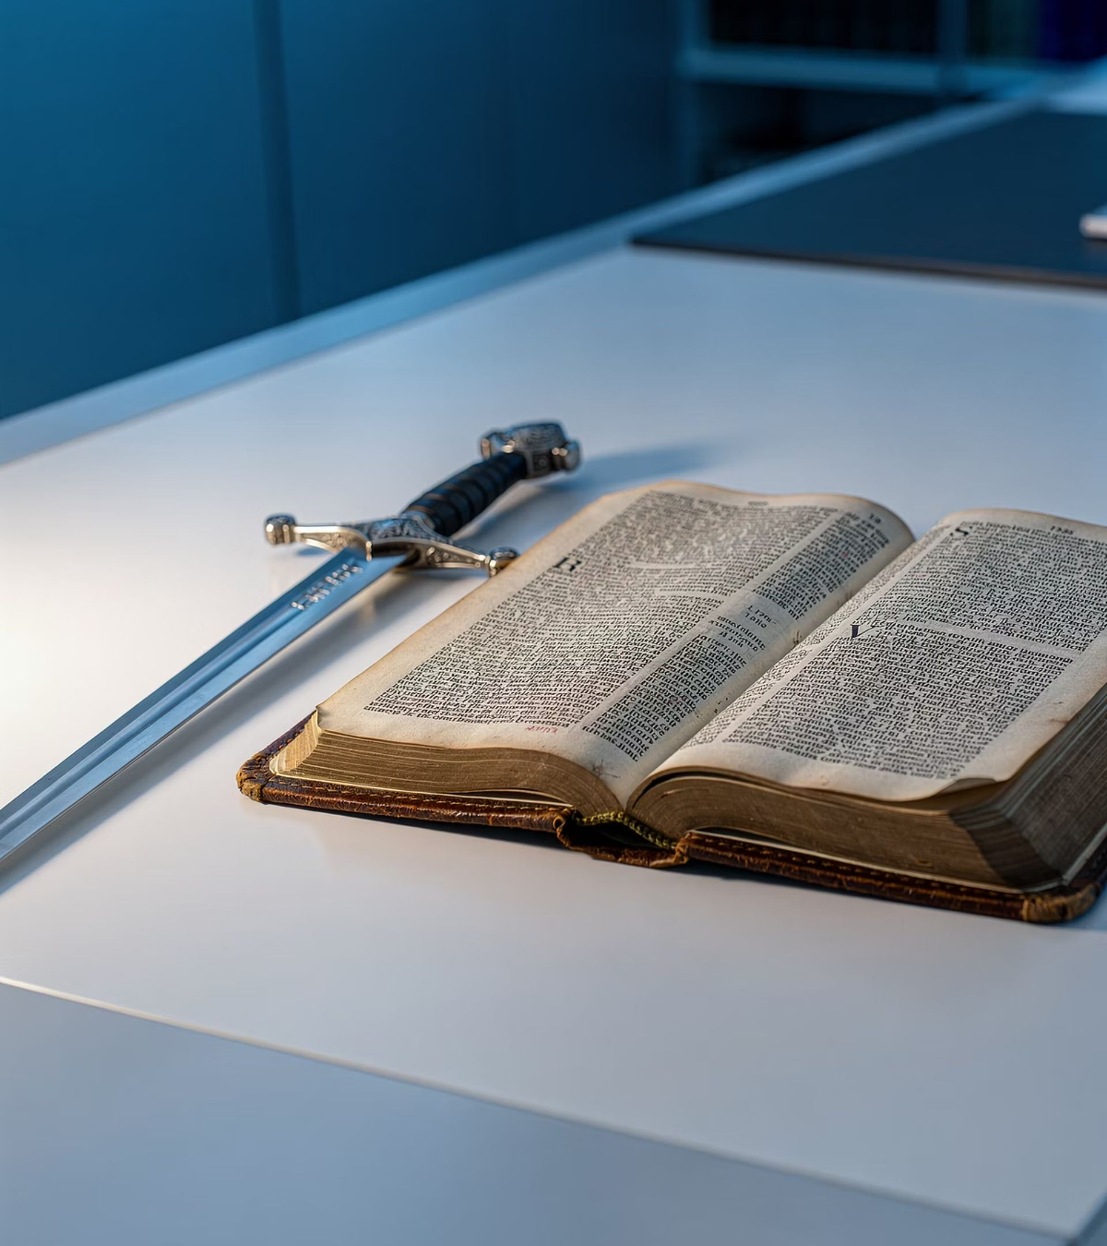
Critical Answer!
Are these powerful words, or is there something more powerful than these?
7 / 16

Slide 10
The Hebraic Code of 5787 (תשפ״ז)
Breaking down the Hebrew year 5787 reveals a powerful prophetic mandate for intercessors:
The 5787 Connection
פ — Pey (80)
ז — Zayin (7)
Matthew 6:10 is the act of unsheathing the Sword (Zayin) using the Mouth (Pey) to establish Heaven's completed order on Earth.
The Mouth. This is the decade of the mouth. Heaven's will is released on Earth when God's people open their mouths in prayer.
The Sword / Weapon. Seven represents completion, divine order, and the weapon — the sword of God's Word.
8 / 16

Slide 11
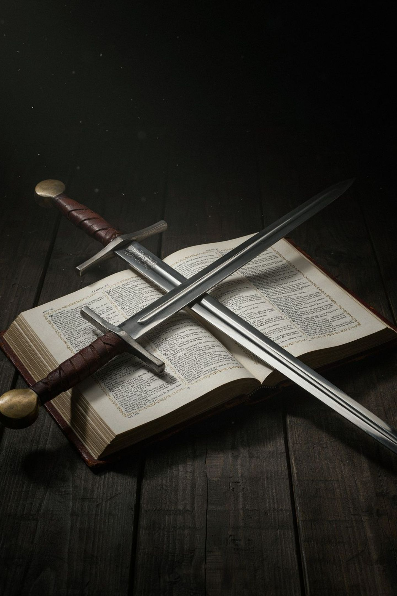
The Word of God: The Ultimate Zayin
In Ephesians 6:17, the "Sword of the Spirit" uses the Greek word Rhema — specifically meaning the spoken word. A sword sitting in a sheath does not win a battle.
Prayer warriors cannot rely on human emotions, opinionated prayers, or anxious begging. They must speak the written and revealed Word of God back to Him (Isaiah 55:11). When an intercessor prays scripture, they are swinging a divine weapon that cuts through spiritual resistance. [Isaiah 55:11 - So shall my word be that goeth forth out of my mouth: it shall not return unto me void, but it shall accomplish that which I please, and it shall prosper in the thing whereto I sent it.]
9 / 16

Slide 12
The Refined Word: פַּז (Paz — Pure Gold)
Gematria 87
Psalm 19:10
Pey + Zayin (פַּז) spells Paz — meaning fine, pure gold. This is the numerical signature of the year's ending unit.
God's Word and judgments are described as "more precious than gold, than much pure gold (paz)." Effective intercession drops human agendas and prays the pure, refined Word of God. Pure prayer produces Heaven's results on Earth.
10 / 16

Slide 13
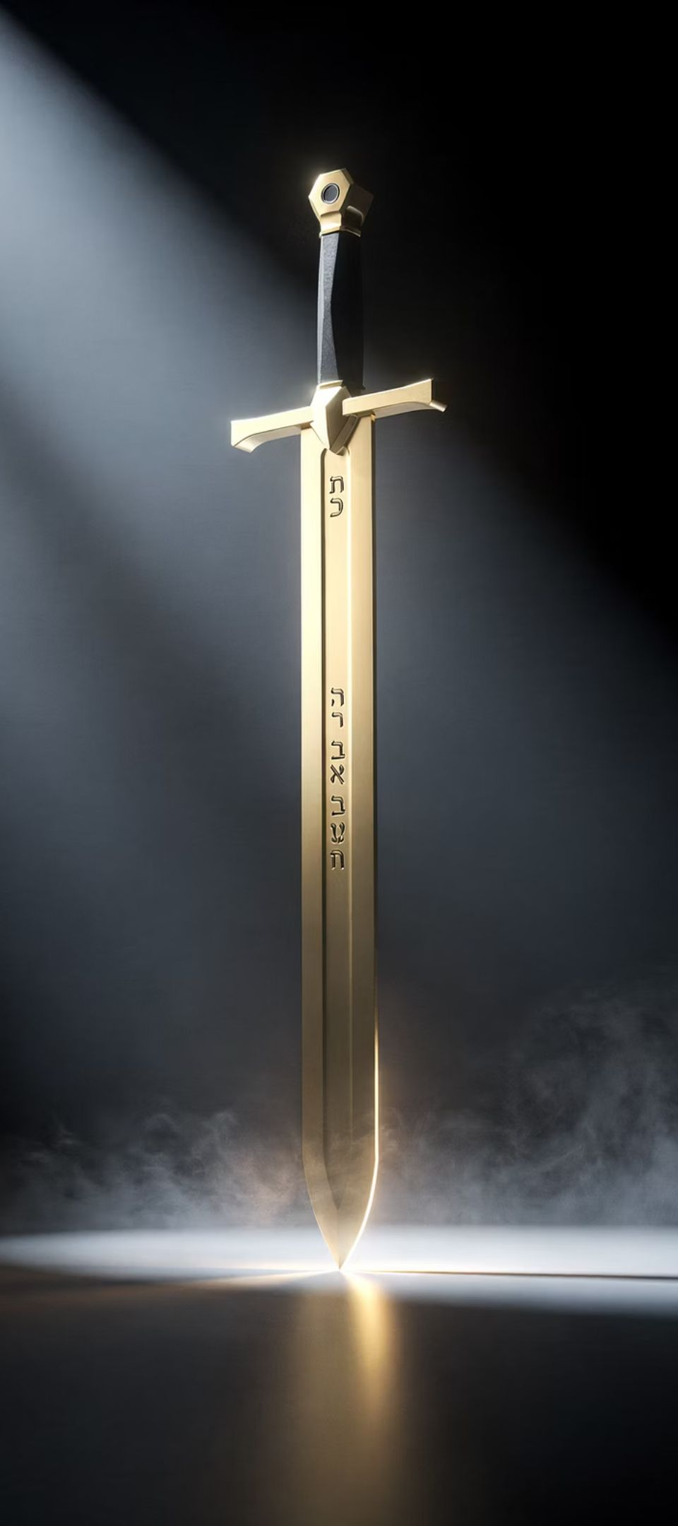
The Refined Word: פַּז (Paz — Pure Gold)
The Hebrew word Paz (פַּז) signifies pure, refined gold – gold purified through intense heat, revealing its ultimate value and brilliance. This metaphor illustrates the inherent power and precision of God's Word in intercession.
"For the word of God is living and effective and sharper than any double-edged sword, penetrating as far as the separation of soul and spirit, joints and marrow. It is able to judge the thoughts and intentions of the heart." — Hebrews 4:12
Just as pure gold is free from dross, the Word of God is unblemished truth, operating with absolute authority. This scripture confirms that the Word is not a dull instrument, but a finely honed, living weapon capable of deep penetration and discernment. It cuts through deception, exposes hidden motives, and brings divine truth to light, making it the ultimate instrument for enforcing Heaven's will.
[Hebrews 4:11 - Let us then make every effort to enter that rest, so that no one will fall into the same pattern of disobedience.]
[Hebrews 4:13 - No creature is hidden from him, but all things are naked and exposed to the eyes of him to whom we must give an account.]
11 / 16

Slide 14
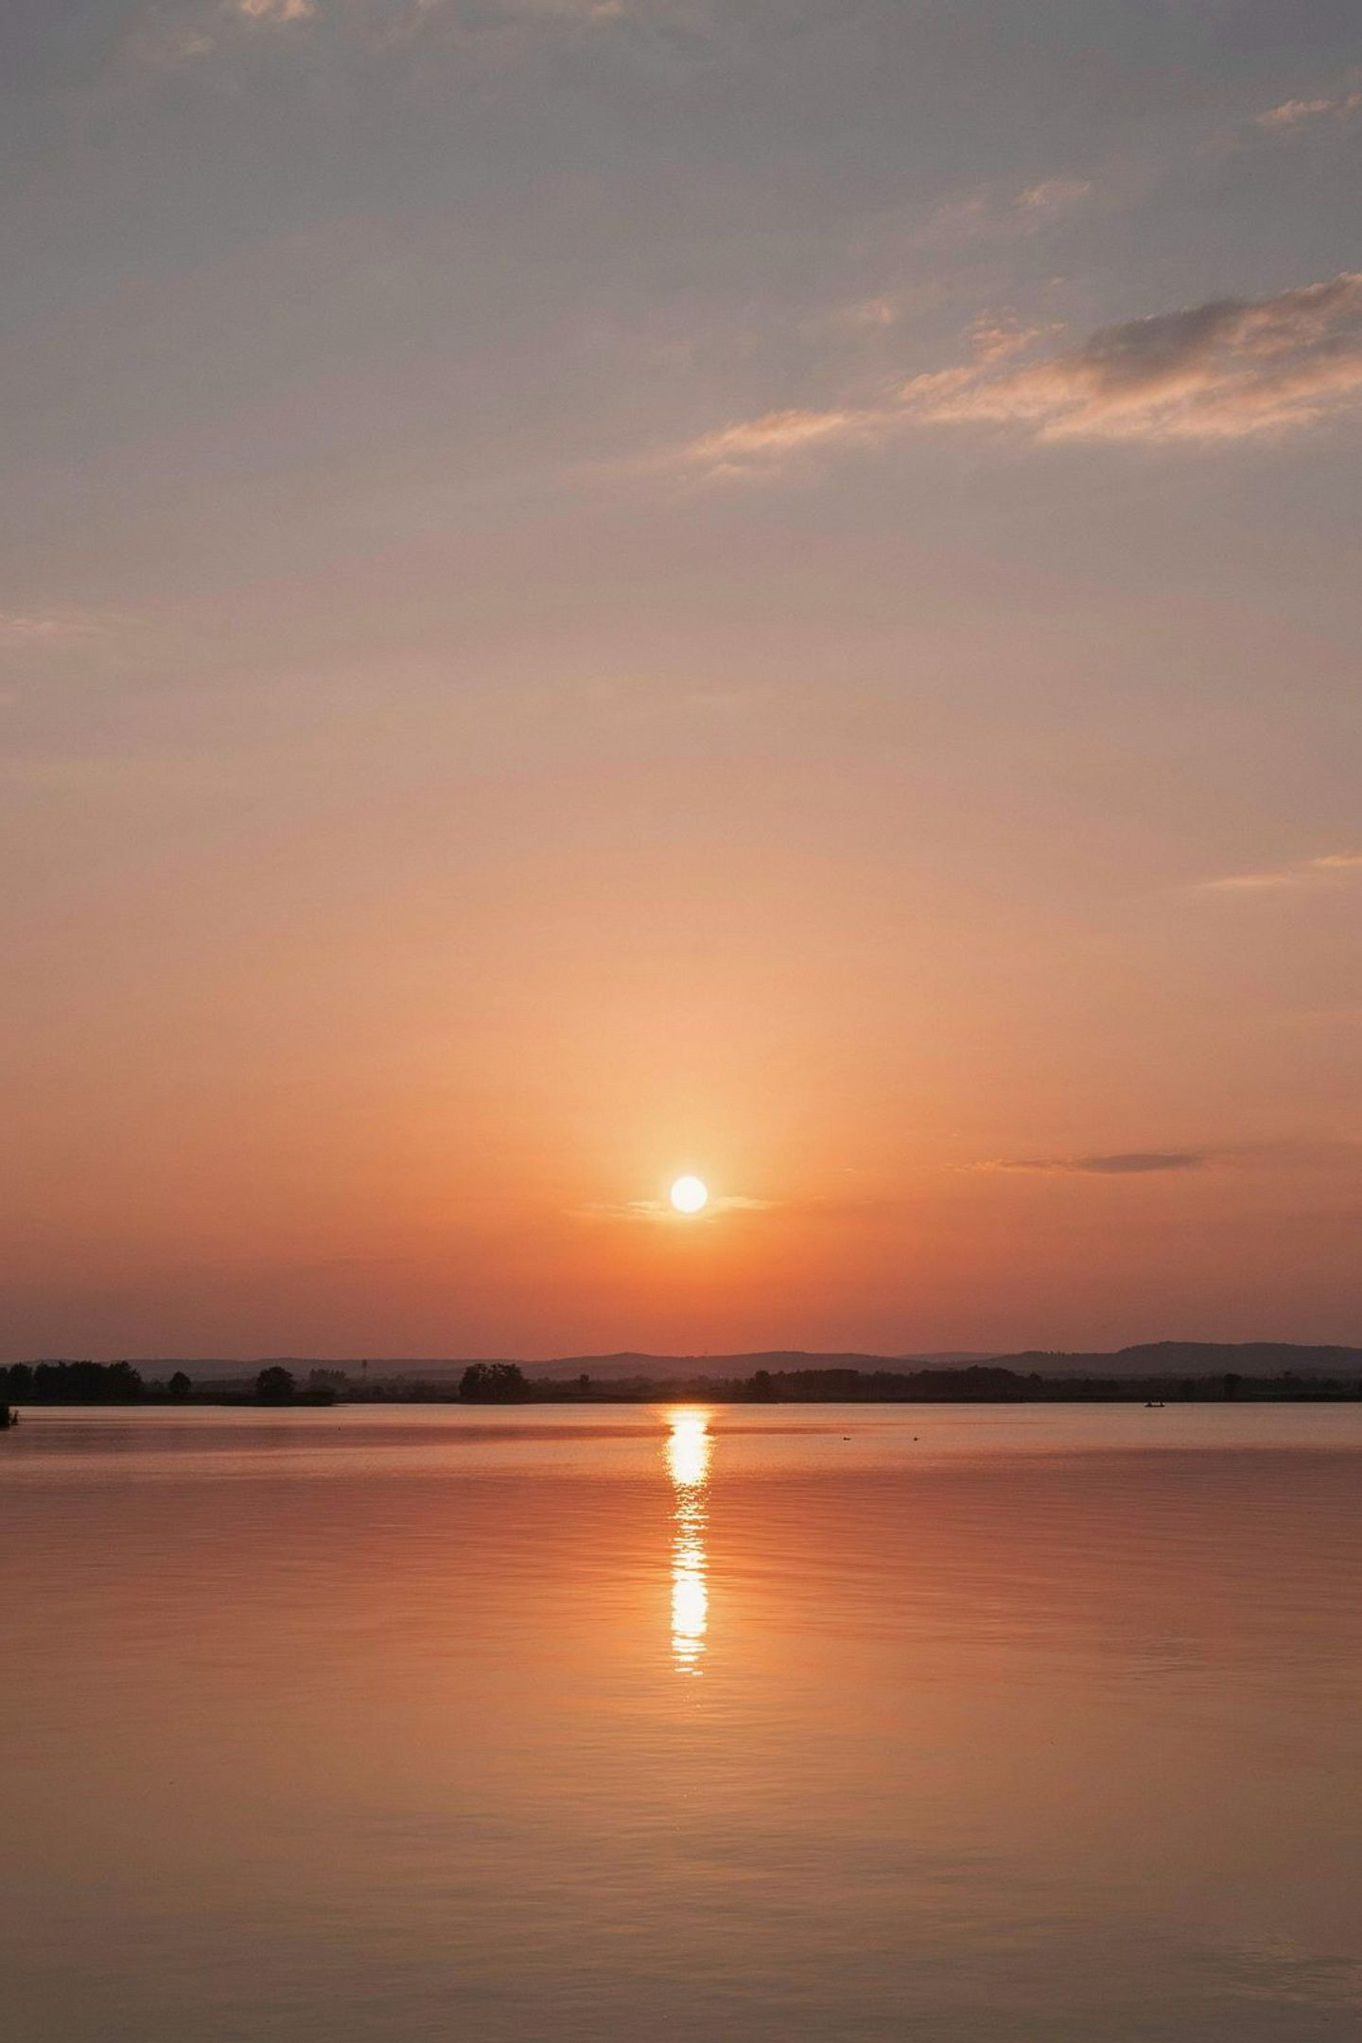


Enforcing Kingdom Order: The Value of 7
The number 7 (Zayin) represents God's rest and completed work. When Jesus taught us to pray "Thy Kingdom come," He was pointing to a Kingdom already complete in Heaven.
Fight From Victory, Not For It
Intercessors do not fight for victory — they fight from victory.
Already Settled in Heaven
Praying the Word allows supplicants to stand in spiritual rest (Zayin), knowing God's Word is already settled in Heaven (Psalm 119:89).
12 / 16

Slide 15
Three Operational Principles for Prayer Groups
When leading prayer warriors through this season, emphasize these three mandates:
1
Shift from Petitioning to Decreeing
2
Anchor Every Prayer in Scripture
3
Stand as the Earthly Echo of Heaven
Move from telling God how big the problem is to telling the problem how big God's Word is. Use the mouth (Pey) to speak the Word (Zayin).
Before praying over a situation, ask: "What scripture promises Heaven's design for this?" Then pray that exact verse over the circumstance.
Heaven holds the authority, but Earth provides the venue. Intercessors become the earthly echo of Heaven's decree through Matthew 6:10.
13 / 16

Slide 16
Key Principles for Intercessors
Principle | Biblical Anchor | Operational Application | Reference
ReferenceThe Word is the Sword | Ephesians 6:17 | The Holy Spirit's primary offensive weapon is the rhema — the Word spoken through your mouth. | Ephesians 6:17 (CSB) - Take the helmet of salvation and the sword of the Spirit—which is the word of God.
Declarations Pre-date Manifestation | Romans 4:17 | Speak God's written decree over a situation before the physical circumstances align. | Romans 4:17 (KJV) - (As it is written, I have made thee a father of many nations,) before him whom he believed, even God, who quickeneth the dead, and calleth those things which be not as though they were.
Faith Comes by Hearing | Romans 10:17 | Speaking the Word aloud strengthens the faith of the one praying while enforcing God's authority in the spiritual realm. | Romans 10:17 (CSB)- So faith comes from what is heard, and what is heard comes through the message about Christ.
14 / 16

Slide 17
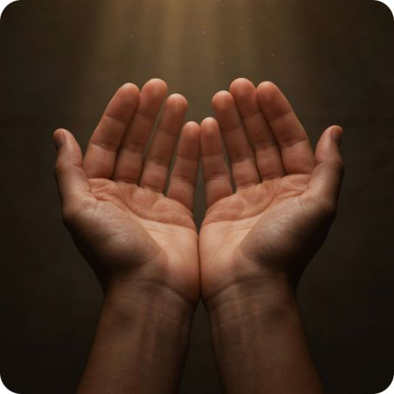
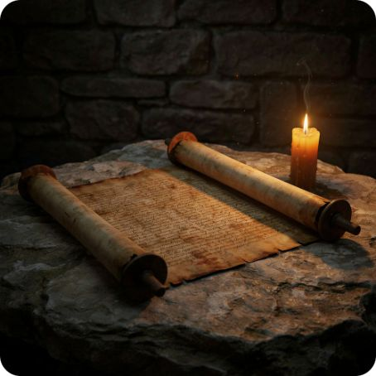

Praying the Word: A Tactical Summary
Speak, Don't Beg
Pray Pure Scripture
Rest in Completed Victory
Rhema prayer is declarative. Open your mouth and release Heaven's established Word over every situation.
Drop human agendas. Paz-level intercession is refined, unadulterated prayer rooted in God's written Word.
Stand in Zayin — the rest of one who knows the battle is already won in Heaven (Psalm 119:89).
15 / 16

Slide 18
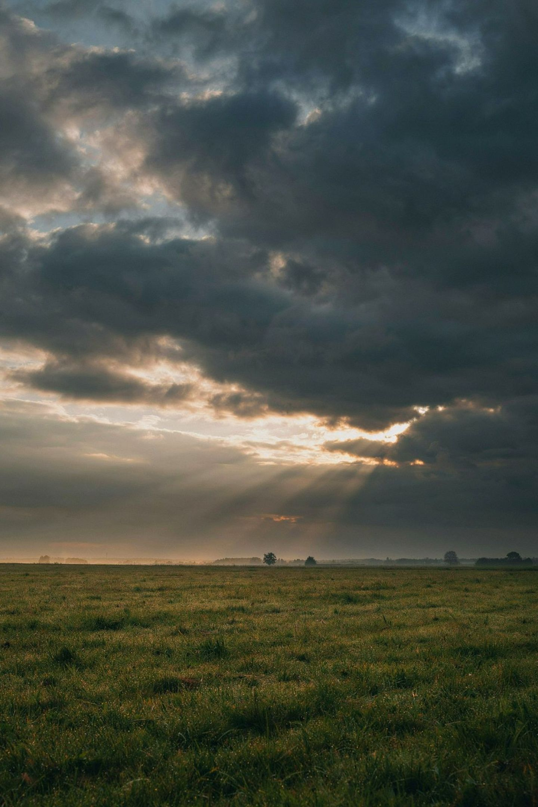

The Call to 5787 Intercession
"Thy kingdom come, Thy will be done on earth as it is in heaven." — Matthew 6:10
In the year of Pey and Zayin, intercessors are called to unsheathe the Sword with their mouths — praying pure, scripture-anchored, Heaven-aligned declarations that enforce God's completed Kingdom on Earth. This is the mandate. This is the moment.
The mouth (Pey) + the Sword (Zayin) = Heaven's will enforced on Earth.
Pray the Word.
Decree the Kingdom.
Stand in rest.
16 / 16

