Slide 1
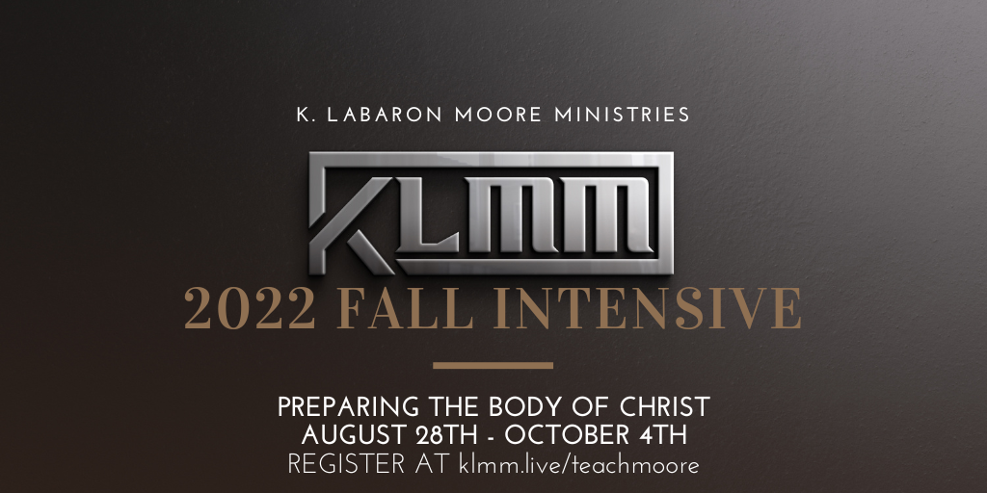

Prophetic Symbols
5780/2020
FALL INTENSIVE 2022/2023
Understanding the Meaning of the Jewish Decade & Years 5780-5784 (2020-2024)
(*Sunday, December 29, 2019/1 Tebat 5780)

Slide 2
Objective
To understand the culmination, the spiritual timing of not only this year, but this Decade was the Kingdom transition.
January 1, 2020. New month, year, and decade for the Kingdom!
Your next, week, month, year and decade!

Slide 3
Text
Exodus 4:1-9 (2)
Exodus 4:10-17
January 1, 2020. New month, year, and decade for the Kingdom!
Your next, week, month, year and decade!

Slide 4
The Decade =10
CURRENT JEWISH (Prophetic) DECADE
The GREGRORIAN DECADE

Slide 5
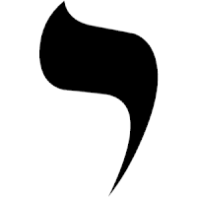
Decade =10

Slide 6


Decade =10
ARM & HAND

Slide 7
Decade =10
ARM-HAND
= Completion
*Smallest of Jewish letters
Literally the “dot”. Without it, in place,
manuscript Is incomplete.
See - Matthew 5:18
ARM & HAND

Slide 8
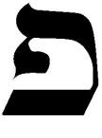
CURRENT JEWISH (Prophetic) DECADE 5780

Slide 9
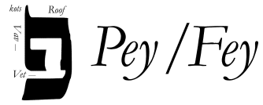

CURRENT JEWISH (Prophetic) DECADE 5780
MOUTH

Slide 10
CURRENT JEWISH (Prophetic) DECADE 5780
EYE (5779)
= Revelation
MOUTH (5780)
= Manifestation
MOUTH

Slide 11

CURRENT GREGORIAN DECADE 2020

Slide 12
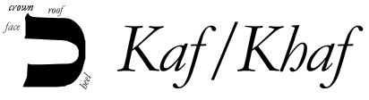

CURRENT GREGORIAN DECADE 2020
PALM/HAND

Slide 13
2020
PALM/HAND =
POTENTIAL TO
ACTUALIZTION
THE BOWL! Double YOD!
PALM/HAND

Slide 14
Consider Biblical Numerology
Yod – 10 - Completion
Pey/Fey – 17
– Overcoming the Enemy
Kaf/Khaf – 20
– Completion of Waiting Period

Slide 15
The Conclusion of the Matter
Yod – Decade of Completion
Pey/Fey – Manifestation-Year of the Mouth
Kaf/Khaf – Actualization of Potential

Slide 16
The Prophetic Years

Slide 17


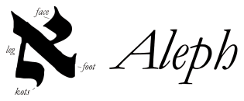
5781
PEY ALEPH
Year of the Voice of Anointed Leaders
MOUTH
OXEN/BULL

Slide 18
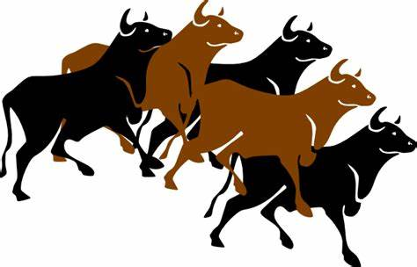

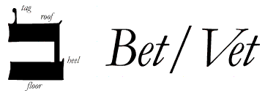
5782
MOUTH
PEY BET
Year of the Voice the
House
HOUSE

Slide 19
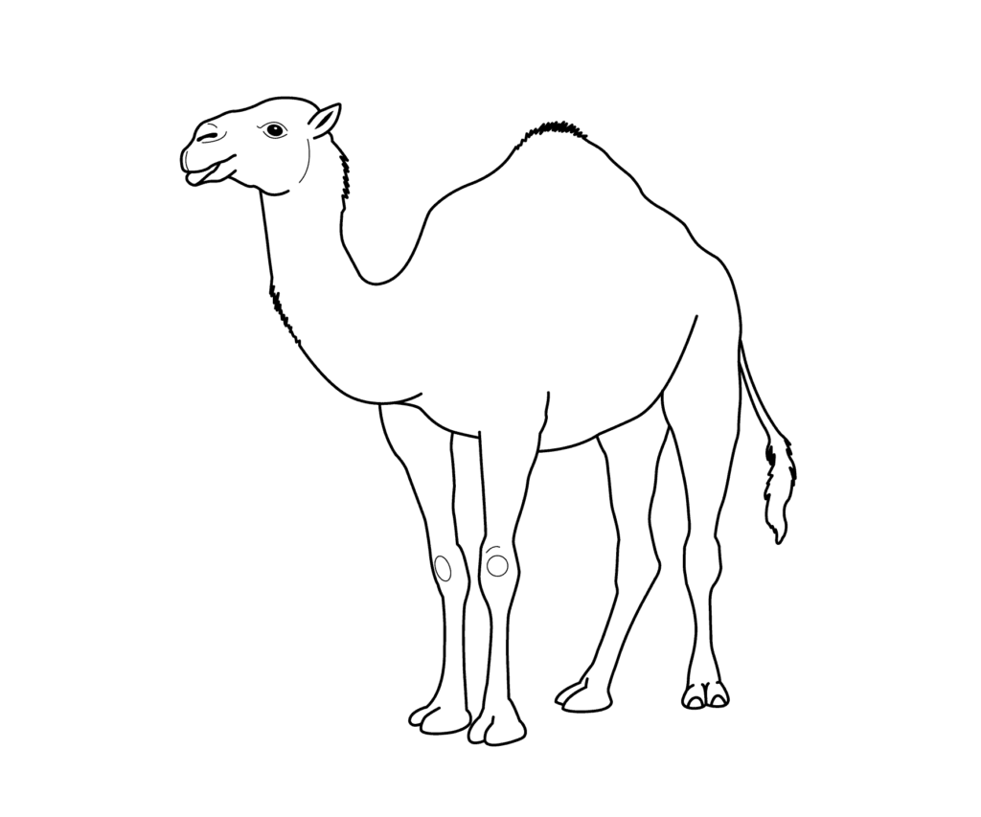

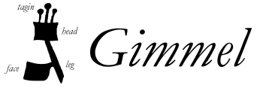
5783
MOUTH
PEY GIMMEL
Year of the
Voice the Camel
CAMEL

Slide 20
5783
ABOUT GIMMEL Gimmel is the third letter of the Aleph-Bet, having the numeric value of three. The pictograph for Gimmel is a camel The"architecture" of the classical Hebrew letter looks something like a man constructed from a Vav and a Yod. Notice the Yod that points to the left, indicating the direction the "man" is walking.
PEY GIMMEL
Year of the
Voice the Camel

Slide 21
5783
ABOUT GIMMEL Mysteries of Gimmel In the Talmud it is said that the Gimmel symbolizes a rich man running after a poor man (the next letter Dalet) to give him tzedakah (charity). (dalut) in Hebrew means impoverished. Gimmel thus represents the free choice to run after the teaching of Torah by practicing acts of chesed (lovingkindness). The root (gamal) means to deal out to, to give, or wean. The word (g'mul) means either recompense or benefit, indicating that the nature of the giving can lead to either blessing or judgment for the one who gives. In other words, how one chooses to "run" the race in Olam Hazeh will determine the outcome of his or her life in Olam Habah. Hence gemilut chasidim is the practice of kindness toward others. Notice the Yod that points to the left, indicating the direction the "man" is walking.
PEY GIMMEL
Year of the
Voice the Camel

Slide 22

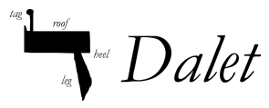
5784
Closed/Hanging Tent Door
PEY DALET
Year – Doors of Opportunity
Tent Door

Slide 23
5784
ABOUT Dalet Dalet is the forth letter of the Aleph-Bet, having the numeric value of four. The pictograph for Dalet – hanging – open tent door The bent shape symbolizes a ”needy” or impoverished person bent over The DOOR symbolizes our option to be closed or open up to the needy/impoverished.
PEY DALET
Year – Doors of Opportunity

Slide 24
Prophetic Symbols
5780/2020
FALL INTENSIVE 2022/2023
Understanding the Meaning of the Jewish Decade & Year 5780-5784 (2020-2024)
(*Sunday, December 29, 2019/1 Tebat 5780)

